Slide 1
Retail and Ecommerce Track and Optimize for All Digital Marketing Channels

Slide 2
Understanding the Customer Journey
Tracking: 82.2% of performance marketers do not have
the ability to measure cross-channel performance or return
on investment. Do you track your customers’ journeys?
Attribution: $137.5 billion is spent on digital advertising.
Do you know the ROI of every dollar you’ve spent?
Optimization: Digital interactions influence 36 cents
of every dollar spent in retail stores, totaling $1.1 trillion
annually. Do you know which channels your customers
interact with before they decide to buy?
Search
Affiliate
Display
Social
Engagement
Video
Mobile
Shopping

Slide 3
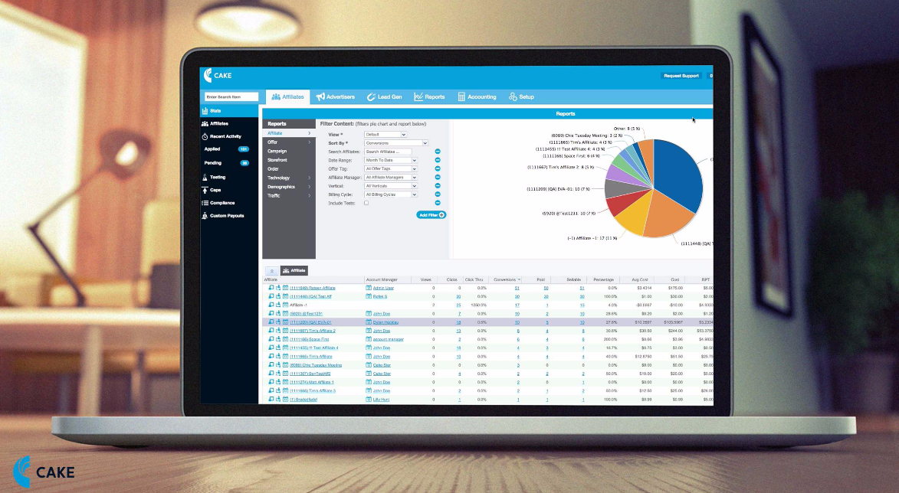
How can you get the most MONEY from your lead flow?
Acquisition Marketing
Email

Slide 4
See clearly, spend better
CAKE’s intuitive SaaS-based platform provides tracking,
attribution and reporting clarity, allowing online retailers to optimize the performance of their digital spend.
Our platform captures and analyzes granular data to
attribute every customer action, pinpointing the digital channels that are the most valuable traffic sources. With this business intelligence, retailers can increase online sales and lead generation.

Slide 5
A single system manages all digital channels:
Multi-channel tracking in real-time covers search, display, email, social, mobile, video, affiliate, direct, shopping and more
Robust reporting structure yields deep insight into the channels that drive digital marketing campaigns
Single-view dashboards let you easily decide where to spend your digital marketing budget
Top-tier integrations work with over 60 technology and service partners
Proven reliability facilitates over 5 billion consumer transactions per month
Intuitive data visualizations provide the ability to make intelligent marketing decisions

Slide 6
CAKE Manages Your Retail & Ecommerce Needs
Custom SKU and Category-based Reports can be shared across your entire organization
Voucher Code Support lets you upload and track unique coupons by source using advanced attribution options
Complete Network Management Tools track and analyze results and guide digital marketing spend choices
Real-time Metrics show exactly which channels are performing

Slide 7
CAKE Manages Your Retail & Ecommerce Needs
Ecommerce Integrations give insight into every level of ecommerce campaign performance
Pixel and Postback Management simplifies workflow to control postback and pixels within virtually any network or platform
Multiple Price Formats can be set by campaign for each conversion or event to track marketing costs across channels
Targeted Campaign Control with real-time optimization of location, device and custom targeting with traffic caps

Slide 8
“We selected CAKE as it offers us an innovative and effective ecommerce solution for tracking, attributing and reporting on the performance of our digital advertising campaigns. CAKE will make it possible to understand our customers’ online journey from the first click to the final sale, accelerating our evolution from an advertising model to a full ecommerce experience.”
Fred Dimesa VP Strategy, Gifts.com

