Slide 1
CAKE
Healthcare Solutions

Slide 2
Agenda
1
Who is CAKE?
2
Problems CAKE Solves
3
Our Approach
4
Healthcare Solutions

Slide 3
Who is CAKE?
Accelerize Inc. (OTCQB: ACLZ) dba CAKE
CAKE product launched in 2010
Offices: Los Angeles, New York, Sydney and London
5+ Billion
500+
71%
100+
Customers
Increasing 50% YoY
Tracking
Consumer actions per month
Revenue
YoY growth (2014)
Employees
72% expansion of team
Notes:
We dominate the space, owning 80% of the affiliate network market.
Pure-play SaaS Performance Marketing company in the AdTech space
Track digital marketing spend from first click to conversion and everything in between to gain insight into the customer journey
Moving upstream from affiliate networks to providing a enterprise digital marketing platform for global advertisers

Slide 4
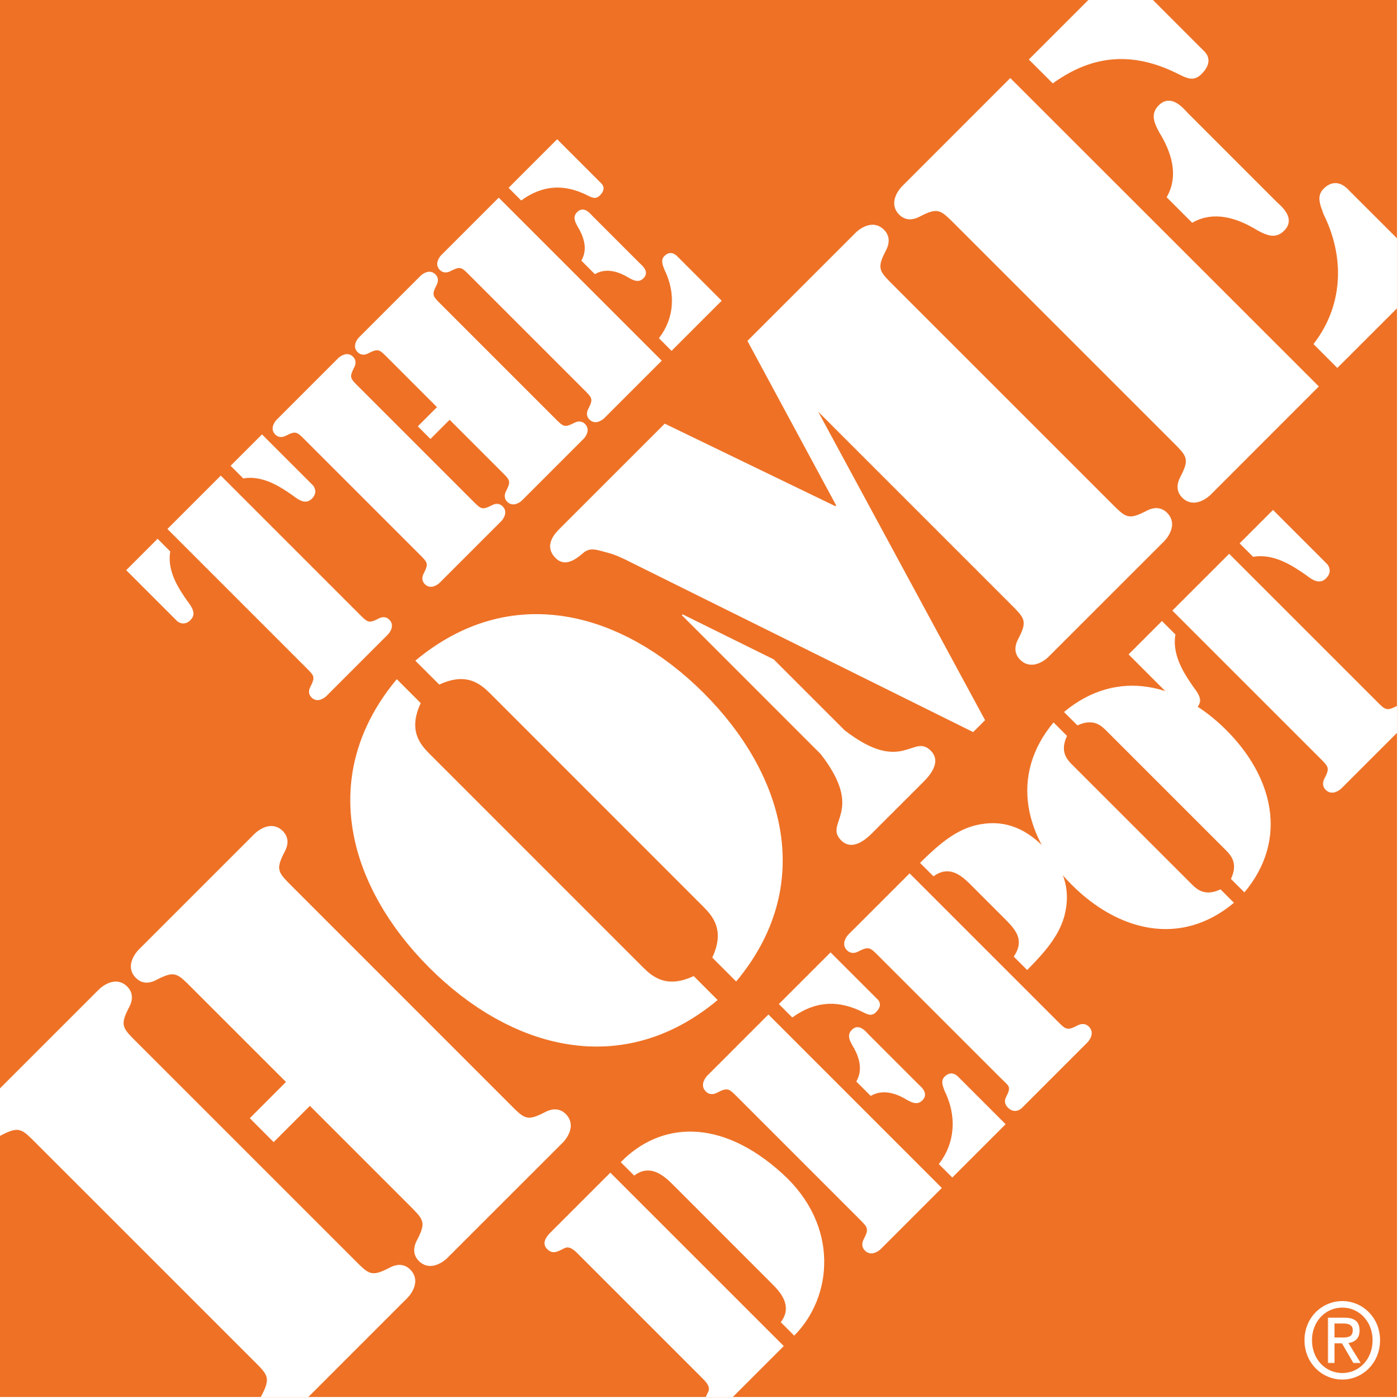
A few of our 500+ customers…
[YOUR LOGO]
a
Notes:
CAKE provides SaaS-based marketing technology solutions for advertisers, publishers and networks.
We specialize in helping advertisers and affiliate marketers with tracking, attribution and optimization.
We have over 450 customers that use our products daily to manage their digital marketing campaigns, including the companies pictured here.
Over five billion customer actions are processed through our products each and every month.

Slide 5
The Problem for the Modern Marketer
Tracking, Attribution, Optimization

Slide 6
“82.2% of marketers do not have the ability to measure cross-channel performance or return on investment.”
Laurie Sullivan
Multichannel Marketing
Notes:
Tracking: 82.2% of retailers do not know all of the steps their customer took before making a purchase. Do you track your customer’s journey?

Slide 7
Companies are spending a lot of money, without knowing if it works
$137.5B
In digital advertising spent in
2014 but where does it go?
Source: eMarketer, October 2014
Notes:
The goal for this meeting is to help you understand you have a problem that you need to fix whether you choose to work with us or not to fix it or not. After you agree that you have a problem, then I will try to convince you that we are the right people to help you fix it.

Slide 8
The Digital Marketing Challenges
Dealing with Fragmented Tools & Data Silos
Limited Visibility into the Customer Journey
No Ability to Measure Cross-Channel
No Digital Marketing Effort ROI
No Customer Lifetime Value
Lack of Lifecycle Marketing
Notes:
The Problem
Marketers are faced with the challenge of implementing and valuating digital campaigns with convoluted, fragmented tools, ambiguous data and multiple systems. This makes it difficult to measure cross-channel performance and ROI. It also makes it difficult for advertisers to understand the customer journey to conversion, including the touchpoints along the way that lead actually lead to conversions, the true ROI of their marketing efforts, as well as the customer lifetime value of their customer segments.

Slide 9
The CAKE Approach

Slide 10
Where to begin?… Anonymous Customer Acquisition
Actionable Marketing Intelligence provides deep insights across the customer journey by measuring cross-channel cost & performance
Tracking: All Digital Channels
Attribution: Multi-touch Conversion Attribution
Optimization: Performance Targeting
Integration: Mktg Automation, Search, Display, etc.
Notes:
Attribution
Understanding the entire customer journey
Knowing exactly where a customer comes from – which channel, ad or keyword
Optimization
Tracking and optimizing the customer’s journey through display, mobile, retail, lead-gen and affiliate channels – true multi-channel real-time targeting
Integration-
Two-way integrations with a wide set of marketing technologies to provide complete insights into the customer’s journey

Slide 11
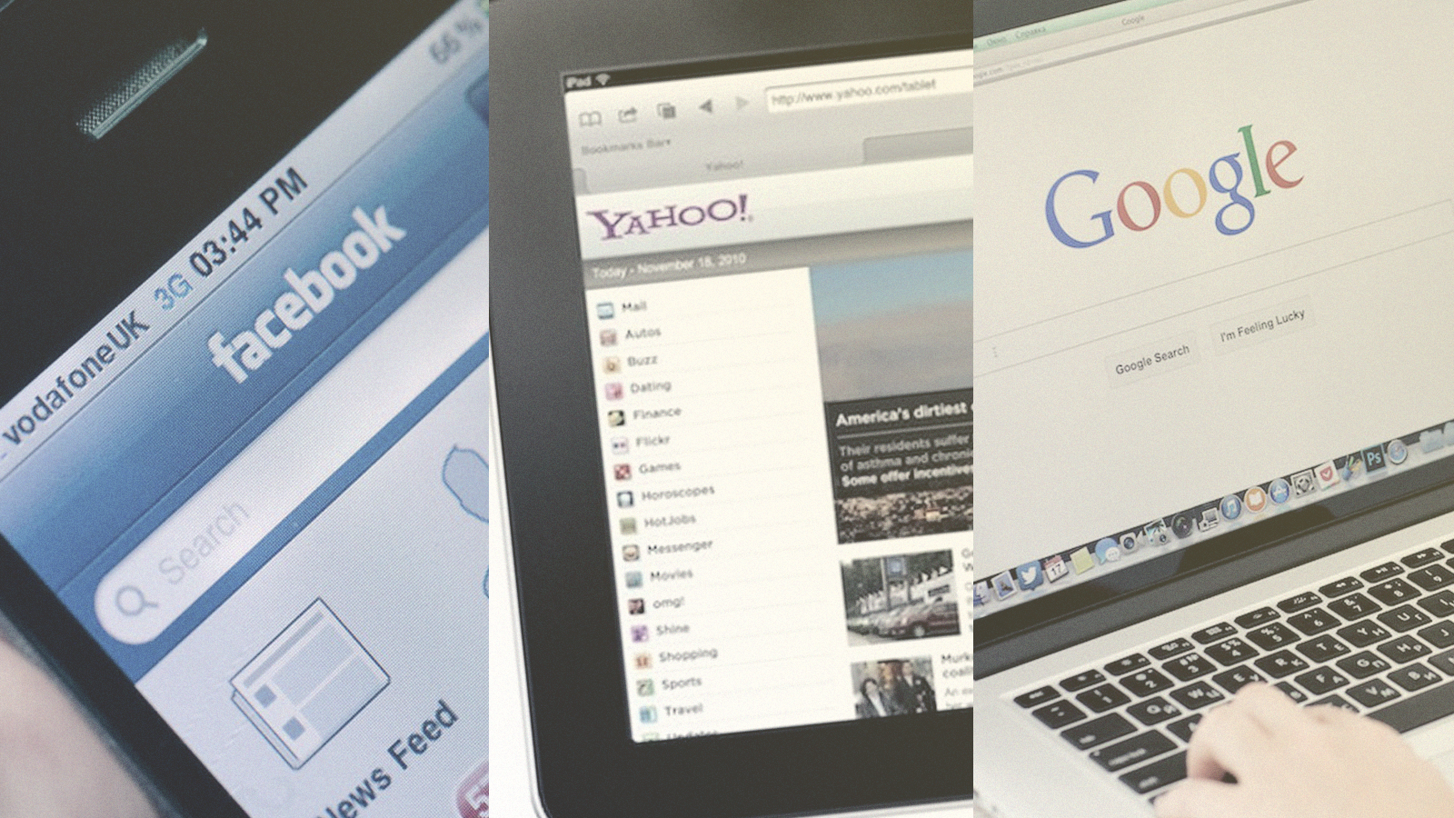
Marketing Intelligence: Tracking
60%* of the Customer Journey occurs before they have spoken to sales
*Corporate Executive Board
Notes:
Erik

Slide 12
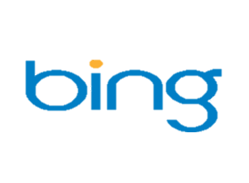
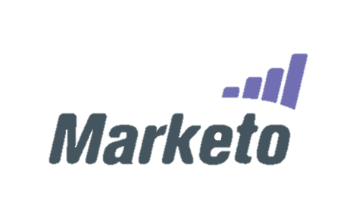
Marketing Intelligence: Tracking & Integration
Affiliate
Search
Display
Social
Actionable Marketing Intelligence
Mobile
Video
Engagement
Shopping

Slide 13
Marketing Intelligence: Attribution Modeling
…it’s not just first/last click
First Click
Last Click
Time Decay
U Shaped
Linear
Custom
Notes:
“[Attribution] is the single least understood concept in digital marketing.” Martin Kihn / Gartner Analyst
Attribution gives insight into what drives conversions, but proper attribution for digital campaigns is no easy feat. Marketers can struggle to credit online campaigns across multiple channels and touch points amid an increasingly fragmented landscape.

Slide 14
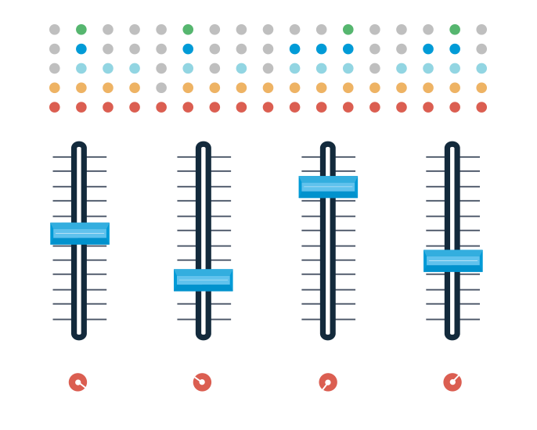
Marketing Intelligence: Optimization
Every day the market shifts, and you need to shift with it. If one channel, word, image or offer is not performing – you need to shift your investments into areas that ARE paying off, or choose new ones.

Slide 15
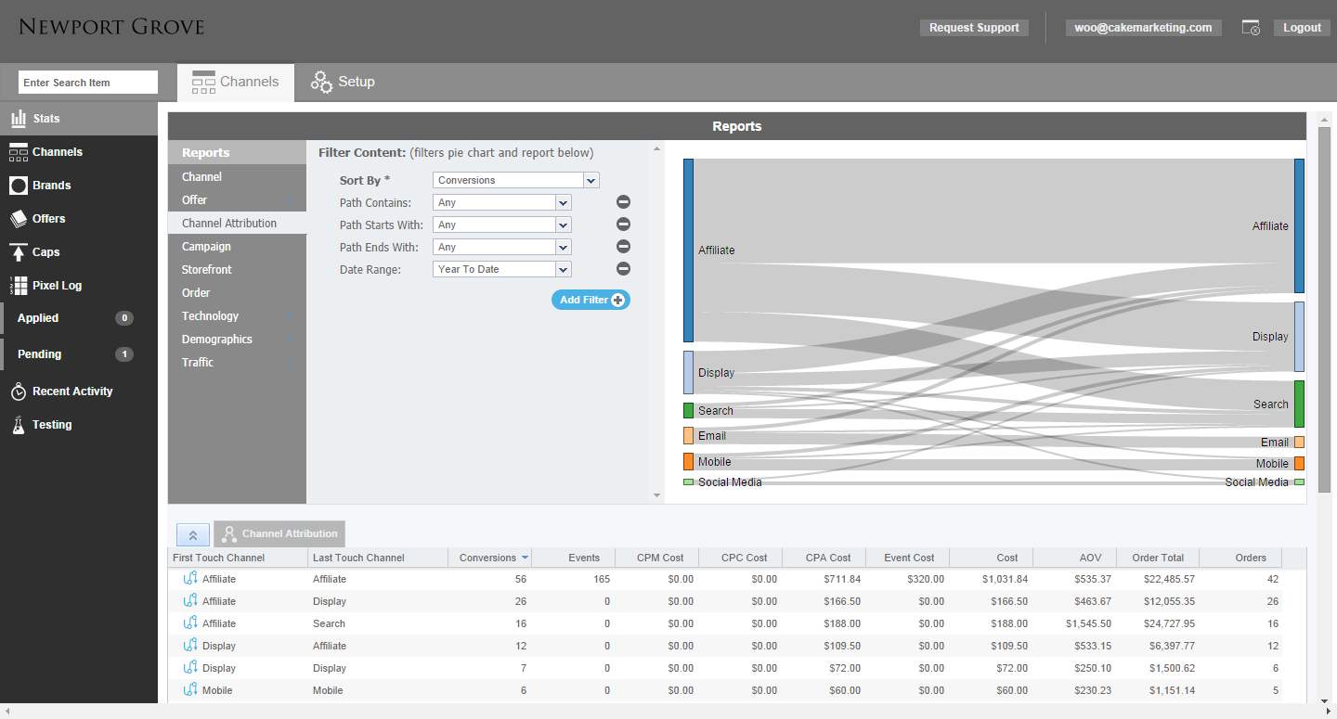
Marketing Intelligence: Optimization

Slide 16
Marketing Intelligence: Optimization

Slide 17
Journey From Anonymous to Customer Lifetime Value
Display Ads | Ecommerce | Search | Lead Forms | Social Ads | Affiliates | Mobile Ads
Anonymous Customer Tracking
Customer
Acquisition &
Engagement
Marketing Automation
Actionable Marketing Intelligence
Customer Lifetime
Value
Lead
Tracking
Customer Relationship Management
Customer Purchase

Slide 18
The Solution
Before
After
Fragmented Tools & Data Silos
Poor Visibility into Customer Journey
Don’t Understand Behaviors and Context
Track the Complete Journey
Anonymous Web Surfing
Prospect Nurturing
Customer Lifetime Value
Attribution for Every Step
Give credit as appropriate
Don’t lose sight of the value of each touch
No Cross-Channel Measurement
No Digital Marketing ROI
Optimize Digital Marketing for the full, tracked cycle
Lack of Lifecycle Marketing
Notes:
The Problem
Marketers are faced with the challenge of implementing and valuating digital campaigns with convoluted, fragmented tools, ambiguous data and multiple systems. This makes it difficult to measure cross-channel performance and ROI. It also makes it difficult for advertisers to understand the customer journey to conversion, including the touchpoints along the way that lead actually lead to conversions, the true ROI of their marketing efforts, as well as the customer lifetime value of their customer segments.

Slide 19
Healthcare Solutions

Slide 20
Healthcare Digital Marketers Need Help!
US healthcare marketers will spend $1.64 billion on digital advertising in 2015
By 2019, that spending will increase to $2.55 billion
New products and sophisticated data targeting will fuel growth, especially in mobile, video and native formats
Marketers need insight into the digital channels that are performing best so their spend can be optimized
Technology is the answer!

Slide 21
Driving Lead Generation Results
Track, Attribute and Optimize Lead Generation Campaigns to:
Drive improvements in time to value
Improve patient and client experience
Consistently match lead buyers with sellers who deliver results

Slide 22
Case Study: Patient’s Guide
The Company
Over two million monthly visitors
20,000 connected patients monthly
Helps medical practitioners, pharmaceutical and medical device companies reach their ideal customer at the opportune moment
Before CAKE
Lead generation was partly programmatic but largely a manual process
Program required substantial human resources
Client onboarding required up to five days to connect system to API for lead transmission
After CAKE
The process is completely automated
Lead flow, from the moment the lead is generated to the reporting dashboard, is now streamlined
Greater capability to monetize each lead

Slide 23
“CAKE has transformed our lead generation program. The marketing platform has allowed us to streamline our process to deliver quality leads, while also significantly reducing our costs and management time regarding logistics and reporting. As a result, we can focus on other vital aspects of our business – provide a better service, dedicate more time to our clients and ultimately, increase profitability. It’s hard to imagine working without CAKE.”
Jasson Gilmore
CEO
Patient’s Guide

